Slide 1
Synchronization for Fault-Tolerant Quantum Computers
Satvik Maurya, Swamit Tannu
University of Wisconsin-Madison
June 24, 2025
International Symposium on Computer Architecture (ISCA 2025)

Slide 2
Outline
Quantum error correction
Logical operations
Synchronization: what, why, how?
Synchronization policies
Running extra rounds
Passive
Active
Hybrid
Results

Slide 3


Quantum error correction
Encode
One or more logical qubits
A single noisy physical qubit
Many noisy physical qubits
Surface code
qLDPC codes
Color codes

Slide 4

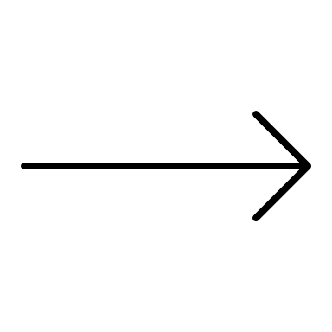
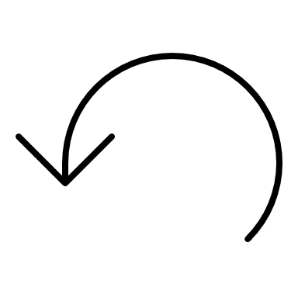
Quantum error correction
Check/measure qubits
Syndromes
001001000001
001001000001
001001000001
Syndrome
Generation
Circuits
Measure
subset
001001000001
001011000001
001011000001
Many physical qubits
Decode

Slide 5
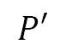
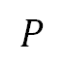
Logical operations
Transversal operations
Require 3D connectivity
Good for neutral atoms/trapped ion qubits
$$P$$
$$P′$$
Lattice Surgery
Logical qubits
Performing computation with logical qubits require
logical operations
Requires only nearest neighbor connectivity
Good for superconducting qubits

Slide 6
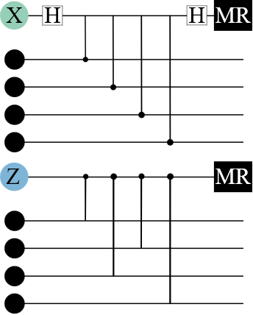
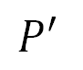
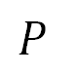
Logical operations – Lattice Surgery
$$P$$
$$P′$$
Syndrome generation
circuit
Logical qubits

Slide 7
Logical operations – Lattice Surgery
$$P$$
Lattice Surgery can be used to implement a variety of logical operations
$$P′$$
Logical qubits
Merge
Split

Slide 8

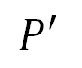
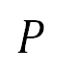
Why is synchronization important?
$$P$$
$$P′$$

Slide 9
Why is synchronization important?
$$P$$
$$P′$$
Merged patch

Slide 10
Why is synchronization important?
$$P$$
$$P′$$
Merged patch
Lattice surgery requires the gate schedule across both patches to start at the same time in the merged patch

Slide 11

Why is synchronization important?
$$P$$
$$P′$$
Merged patch
Lattice surgery requires the gate schedule across both patches to start at the same time in the merged patch

Slide 12
Why is synchronization important?
$$P$$
$$P′$$
Merged patch
Lattice surgery requires the gate schedule across both patches to start at the same time in the merged patch

Slide 13
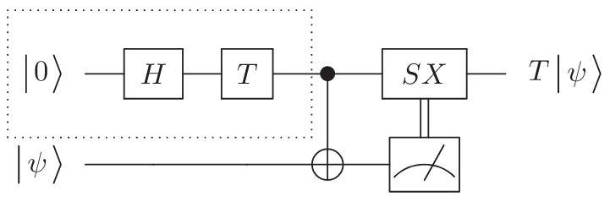
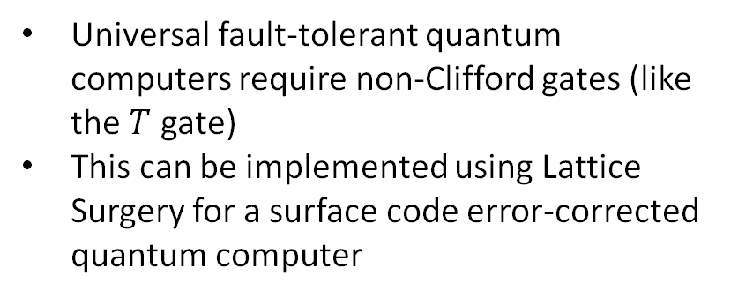
Sources of desynchronization
Universal fault-tolerant quantum computers require non-Clifford gates (like the $T$ gate)
This can be implemented using Lattice Surgery for a surface code error-corrected quantum computer

Slide 14
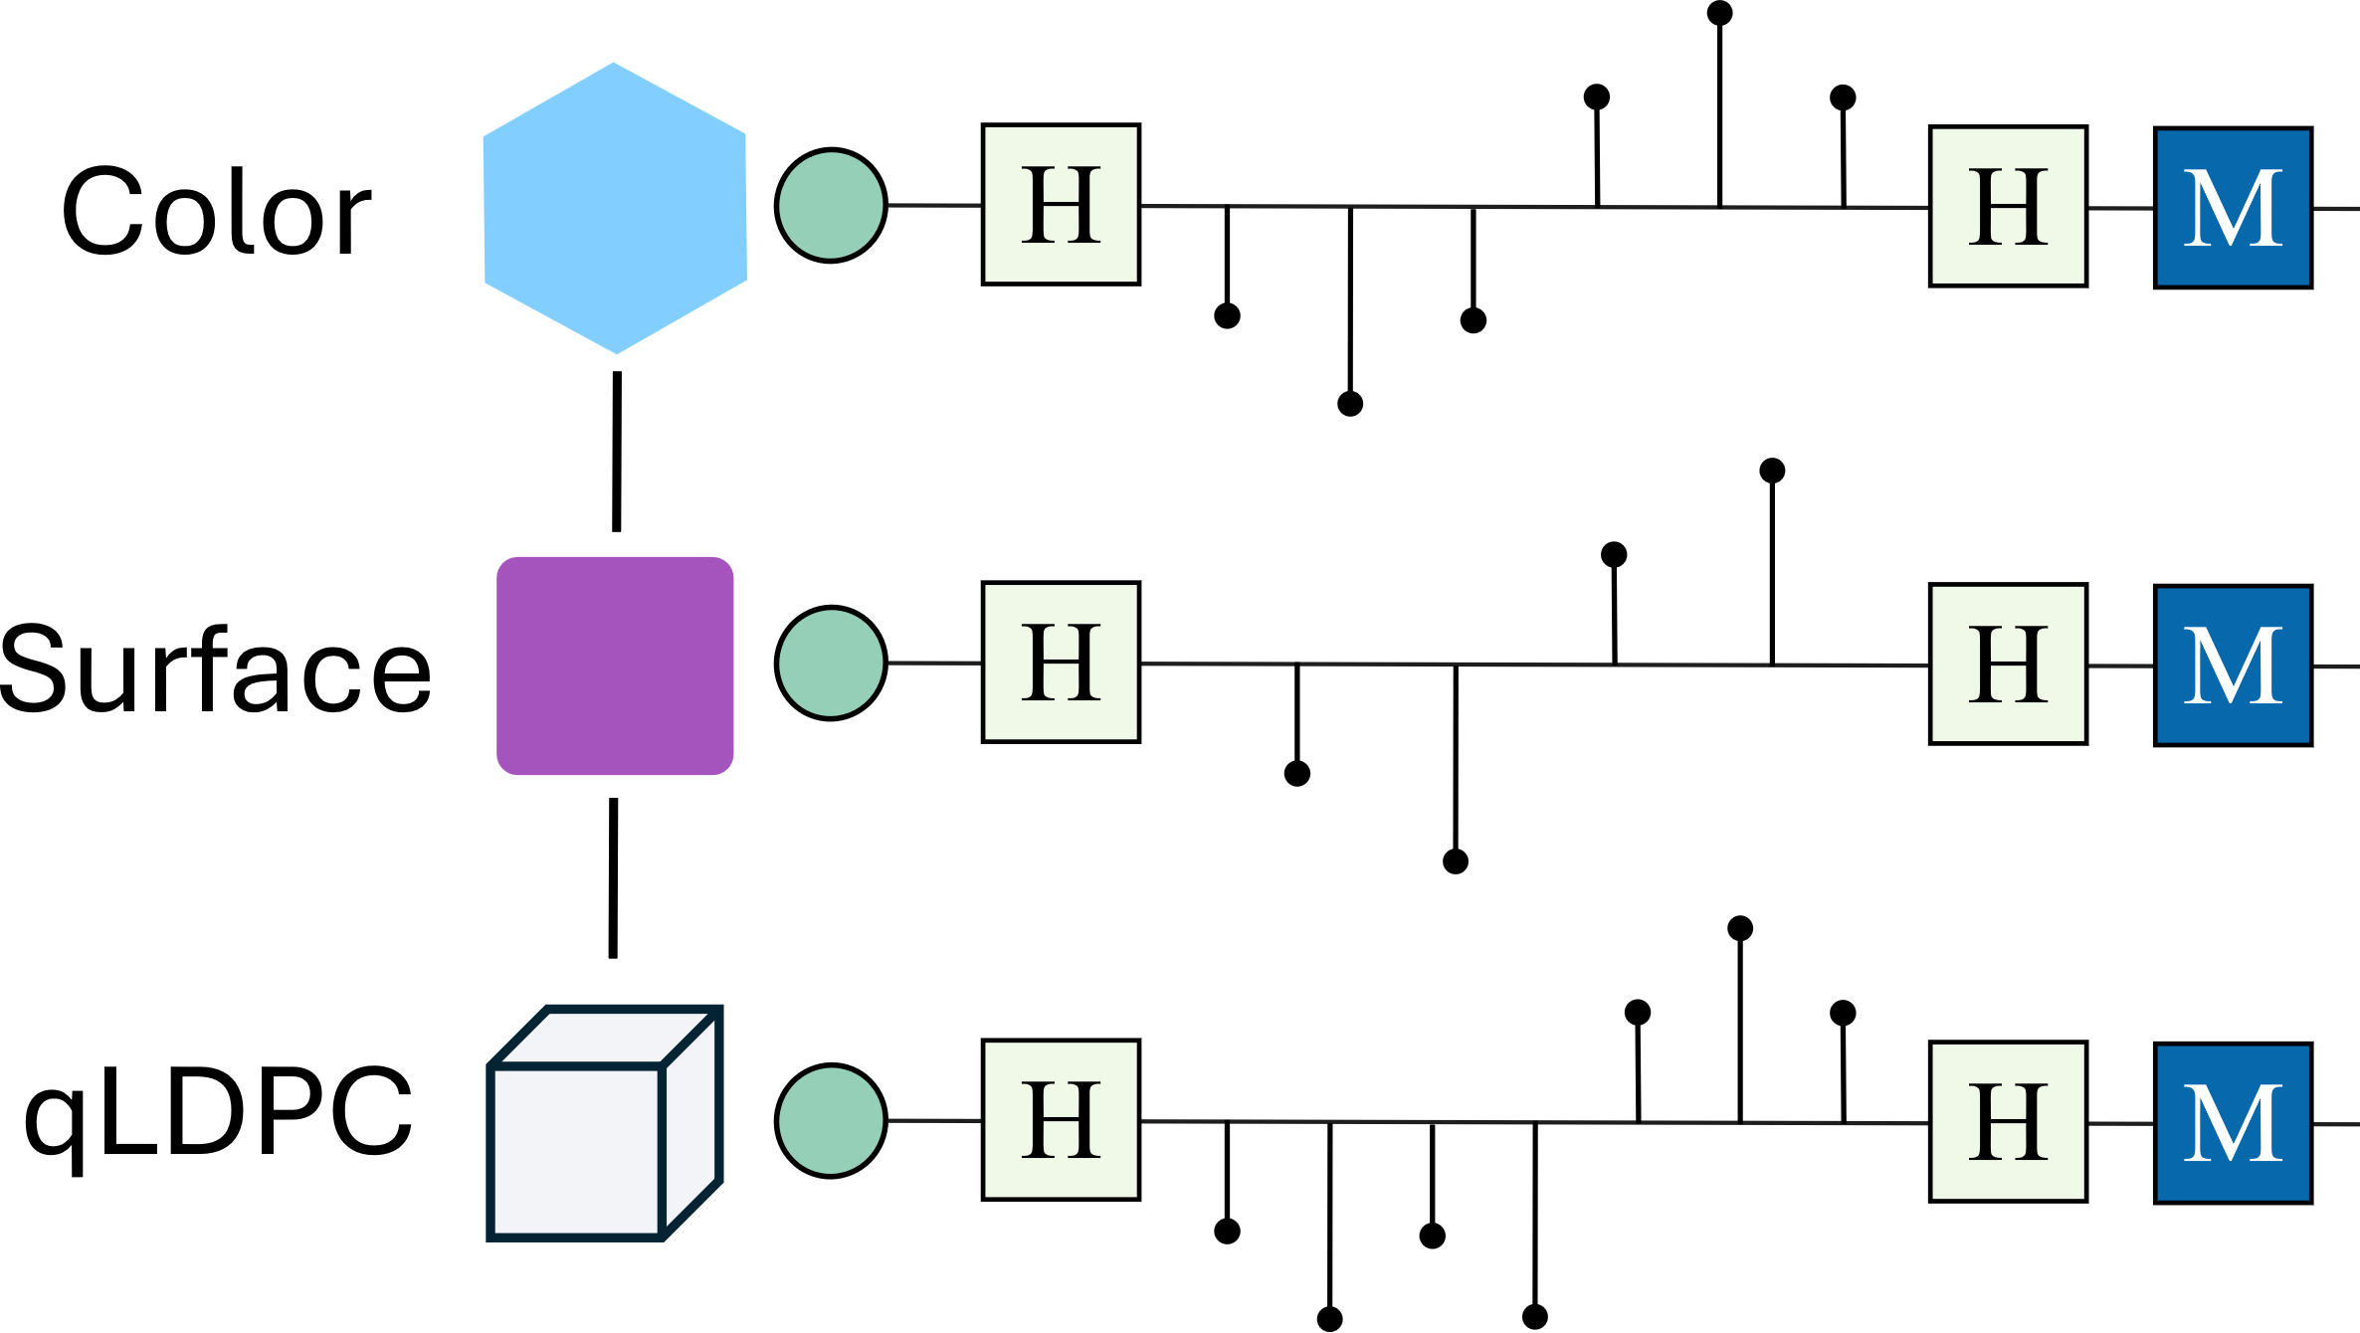
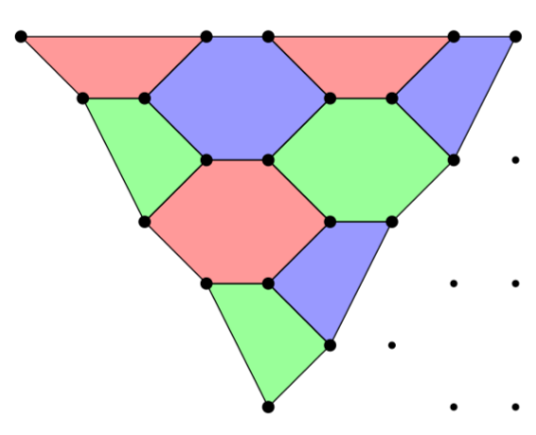
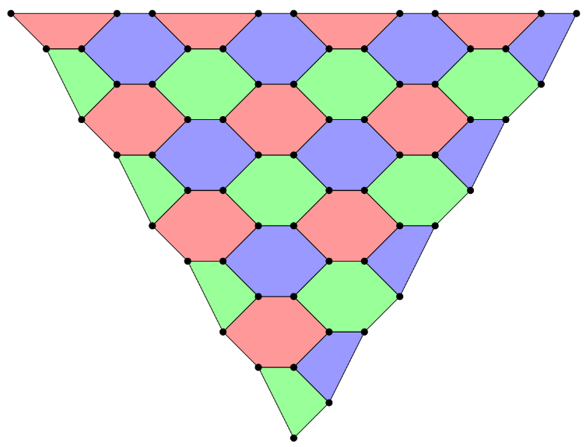
Sources of desynchronization
Magic state cultivation† reduces the overhead of generating magic states by several orders of magnitude compared to distillation-based protocols
The use of heterogeneous codes‡ will require synchronization
Grow/”cultivate”
If error
detected
T injection
Classical feedback required – not deterministic!
‡Stein, S., Xu, S., Cross, A. W., Yoder, T. J., Javadi-Abhari, A., Liu, C., ... & Li, A. (2025, March). HetEC: Architectures for Heterogeneous Quantum Error Correction Codes. In Proceedings of the 30th ACM International Conference on Architectural Support for Programming Languages and Operating Systems, Volume 2 (pp. 515-528).
†Gidney, C., Shutty, N., & Jones, C. (2024). Magic state cultivation: growing T states as cheap as CNOT gates. arXiv preprint arXiv:2409.17595.

Slide 15
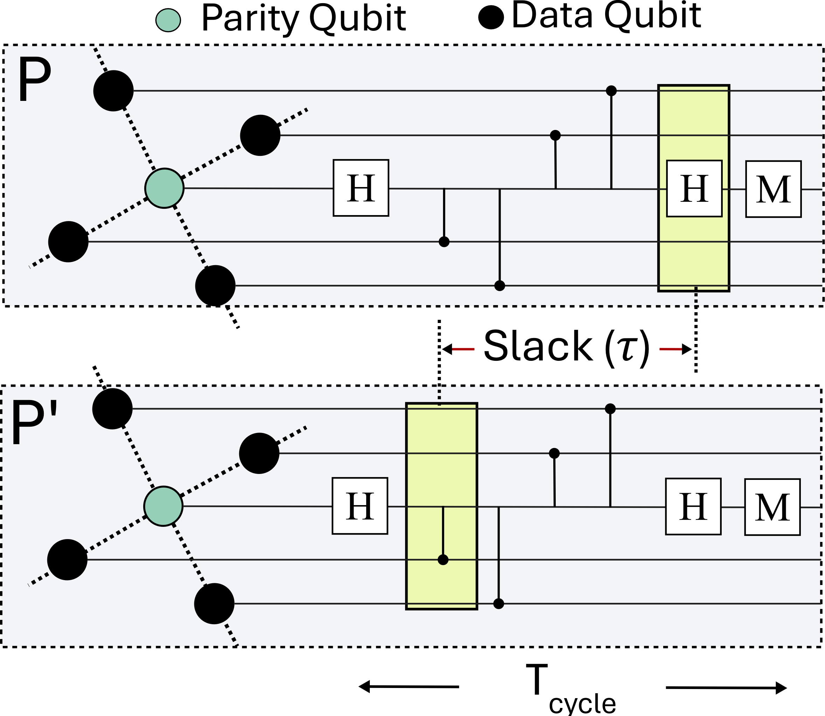
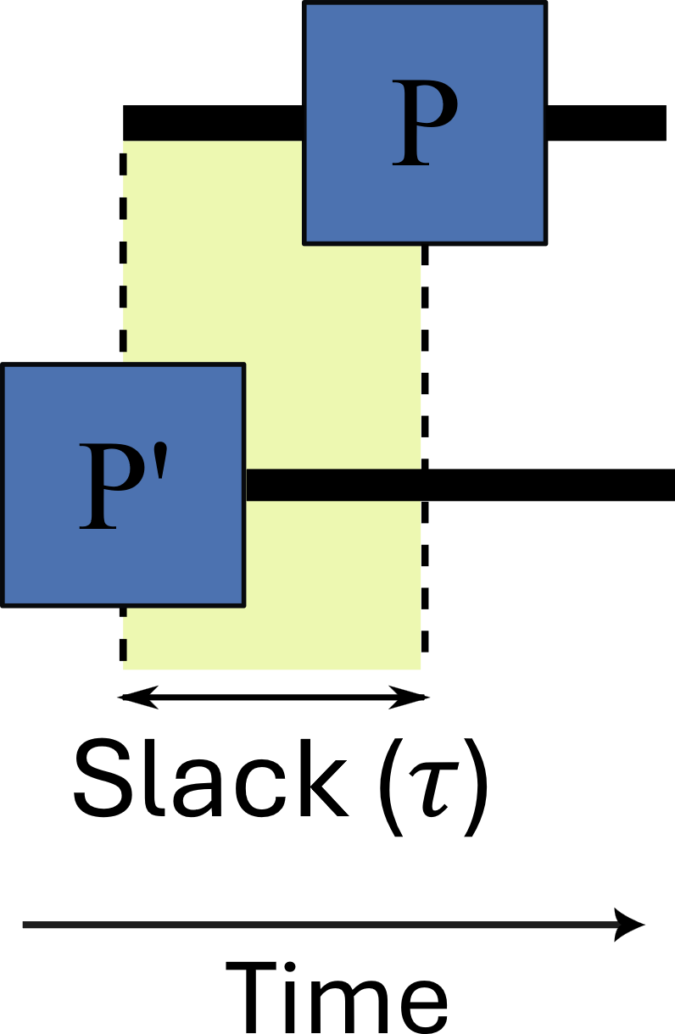
Synchronizing logical qubits
Synchronize
before lattice
surgery merge

Slide 16
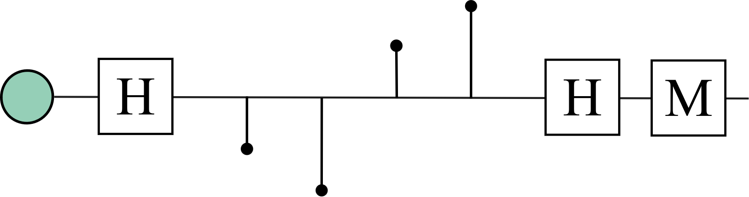
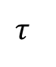
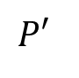
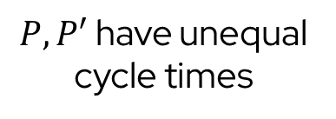
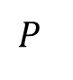
Synchronization policies: Just run extra rounds
$P, P′$ have unequal cycle times
$$P$$
Round 1
Round 2
Round n
Round x
$$τ$$
$$P′$$
Round 1
Round 2
Round n
Round y
Time
Might require many extra rounds before synchronization is achieved

Slide 17
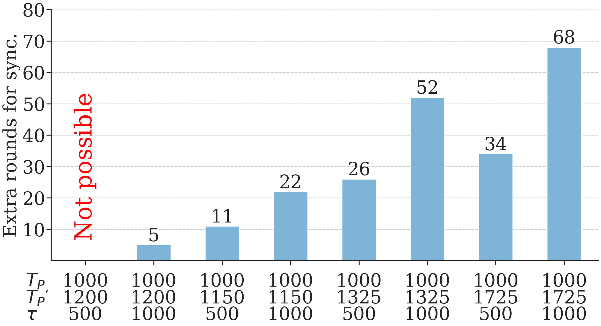
Just running extra rounds won’t always work
Number of extra rounds: $yT_{P}^{′}=xT_{P}+τ;(T_{P}^{′}≠T_{P})$

Slide 18
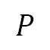
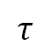
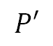
Synchronization policies: Passive synchronization
Idling
$$P$$
Round 1
Round 2
Round n
$$τ$$
$$τ$$
$$P′$$
Round 1
Round 2
Round n
Time

Slide 19
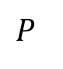
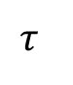
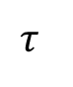
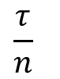
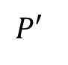
Synchronization policies: Active synchronization
Can we do better than passively idle?
Idling
$$P$$
Round 1
Round 2
Round n
$$τ$$
$$\frac{τ}{n}$$
$$τ$$
$$P′$$
Round 1
Round 2
Round n
Time

Slide 20
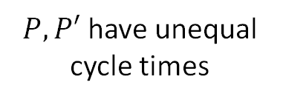
Synchronization policies: Hybrid synchronization
Idling
$P, P′$ have unequal cycle times
$$P$$
Round 1
Round 2
Round n+z
Combine the Active policy with some additional rounds
$$τ$$
$$P′$$
Round 1
Round 2
Round n+z
Time

Slide 21
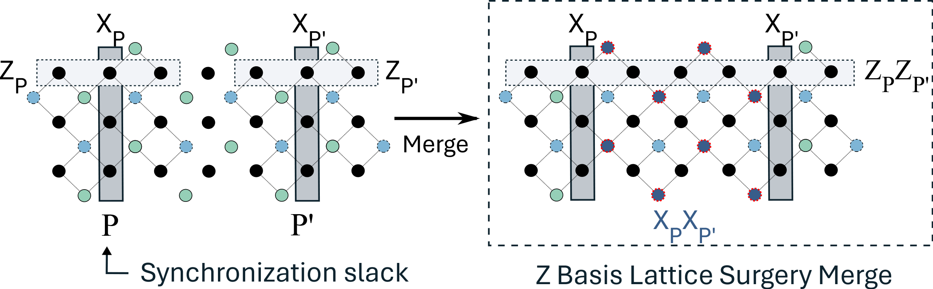
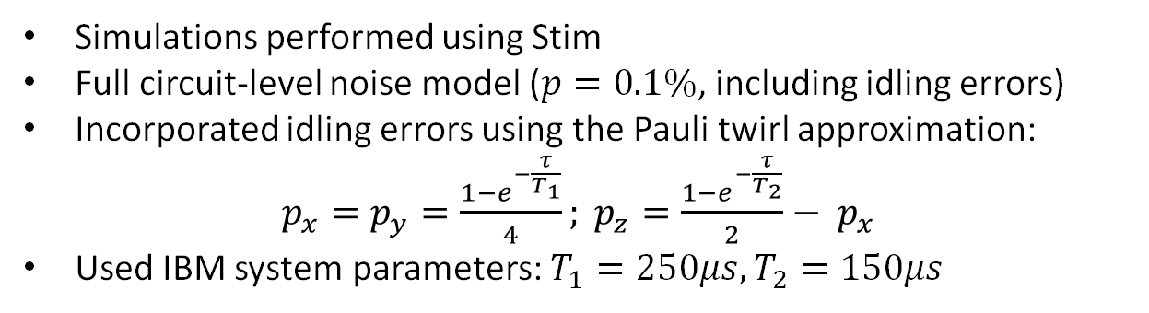
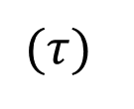
Methodology
$$(τ)$$
Simulations performed using Stim
Full circuit-level noise model ($p=0.1\%$, including idling errors)
Incorporated idling errors using the Pauli twirl approximation:
$p_{x}=p_{y}=\frac{1−e^{−\frac{τ}{T_{1}}}}{4}; p_{z}=\frac{1−e^{−\frac{τ}{T_{2}}}}{2}− p_{x}$
Used IBM system parameters: $T_{1}=250μs, T_{2}=150μs$

Slide 22
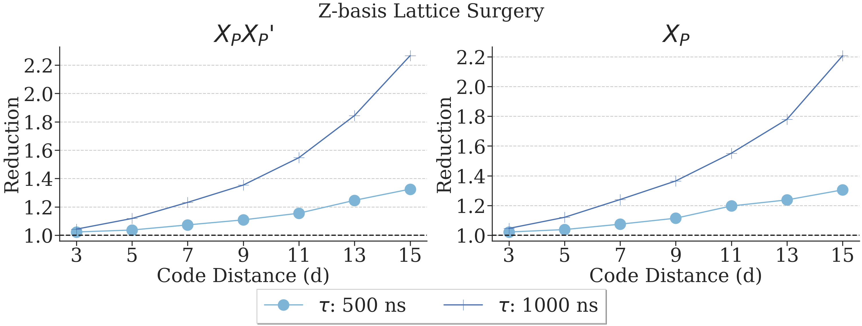
LER reduction with Active synchronization
The Active policy achieves a reduction of up to ~2.2x in the logical error rate compared to the Passive policy

Slide 23
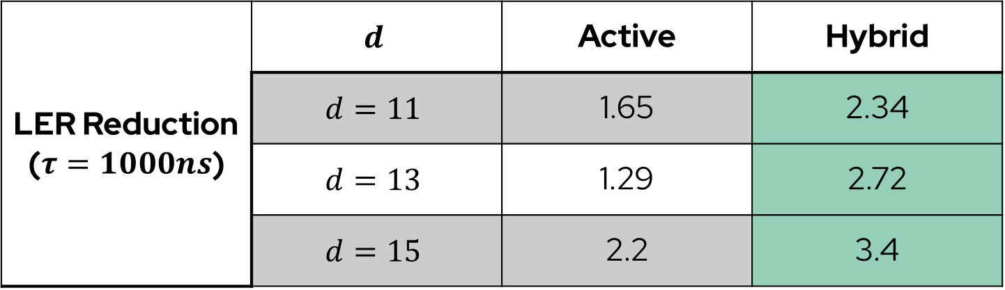
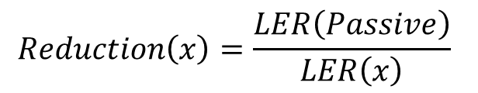
LER reduction with the Hybrid policy
$$Reduction\left(x\right)=\frac{LER\left(Passive\right)}{LER\left(x\right)}$$
LER Reduction ($τ=1000ns$) | $$d$$ | Active | Hybrid
 | $$d=11$$ | 1.65 | 2.34
 | $$d=13$$ | 1.29 | 2.72
 | $$d=15$$ | 2.2 | 3.4
The Hybrid policy can boost the effectiveness of the Active policy

Slide 24
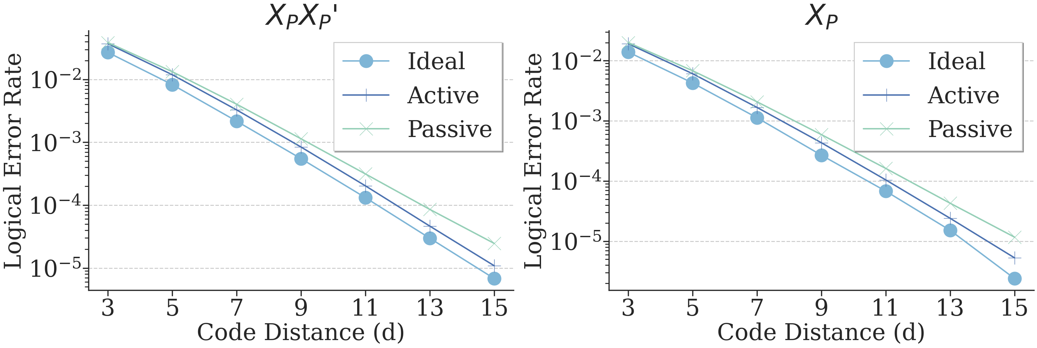
Cost of synchronization

Slide 25
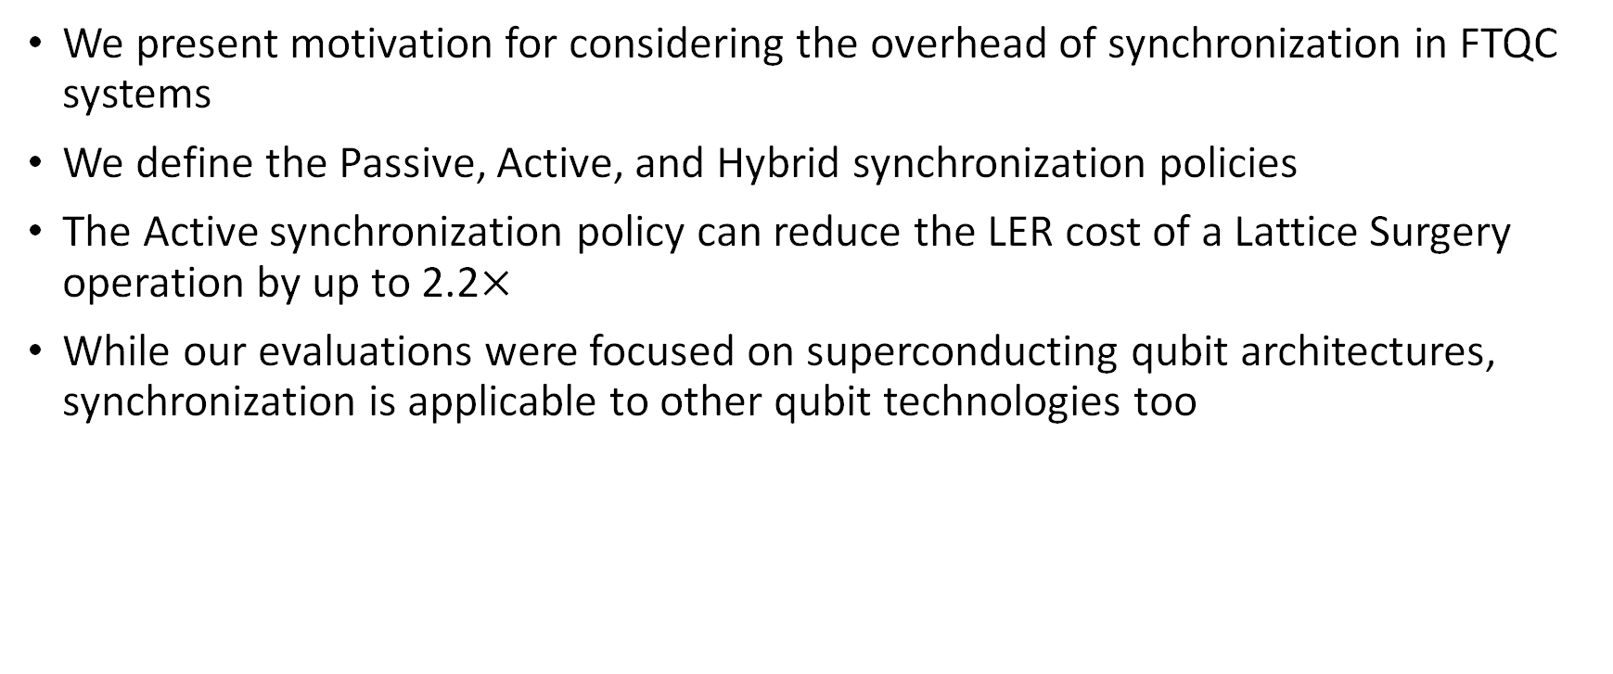
Conclusions
We present motivation for considering the overhead of synchronization in FTQC systems
We define the Passive, Active, and Hybrid synchronization policies
The Active synchronization policy can reduce the LER cost of a Lattice Surgery operation by up to 2.2$×$
While our evaluations were focused on superconducting qubit architectures, synchronization is applicable to other qubit technologies too

Slide 26


Synchronization for Fault-Tolerant Quantum Computers
Satvik Maurya, Swamit Tannu
University of Wisconsin-Madison
Seek me out,
let’s grab coffee and chat!
Paper/code

Slide 27
Backup

Slide 28
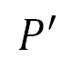
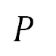
Sources of desynchronization
$$P$$
CNOT latency: 100ns
Desynchronization!
$$P′$$
CNOT latency: 110ns
Non-uniform gate latencies will cause patches to be desynchronized
(easiest source to address/fix)

Slide 29
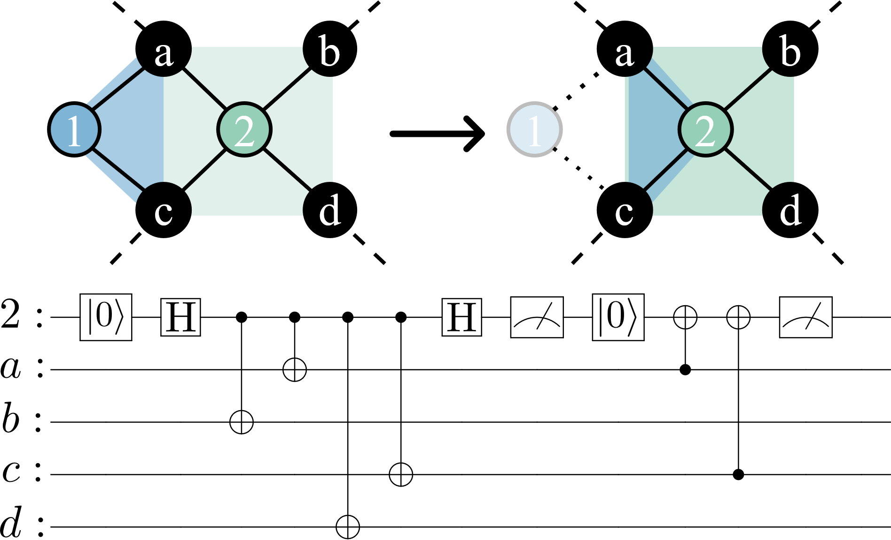


Sources of desynchronization
Speculative LRC
Dropouts/defects † can change syndrome generation cycle times for some qubits
Speculative use of leakage reduction circuits‡ will change cycle times too
† Debroy, D. M., McEwen, M., Gidney, C., Shutty, N., & Zalcman, A. (2024). Luci in the surface code with dropouts. arXiv preprint arXiv:2410.14891.
‡ Vittal, S., Das, P., & Qureshi, M. (2023, October). Eraser: Towards adaptive leakage suppression for fault-tolerant quantum computing. In Proceedings of the 56th Annual IEEE/ACM International Symposium on Microarchitecture (pp. 509-525).

Slide 30
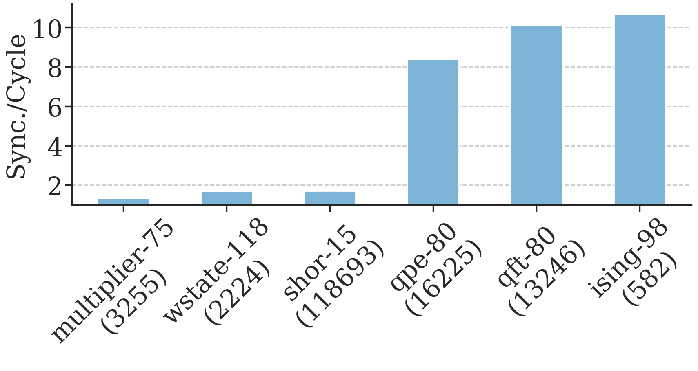
Synchronizations will be needed frequently
Computed using the Azure resource estimation tool, total logical cycles required annotated below the benchmark names.

Slide 31

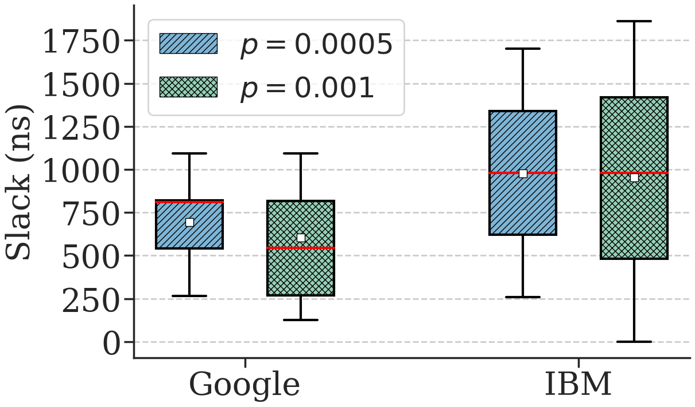
Synchronizations slacks
Injection
Growth/
cultivation
Escape to a larger code
Assuming a cultivation-like protocol for generating non-Clifford states
An error can be detected at any point of the process
Any error detected (detector flip) during injection and cultivation triggers a full restart
Errors are random, hence time to restart is random.

Slide 32
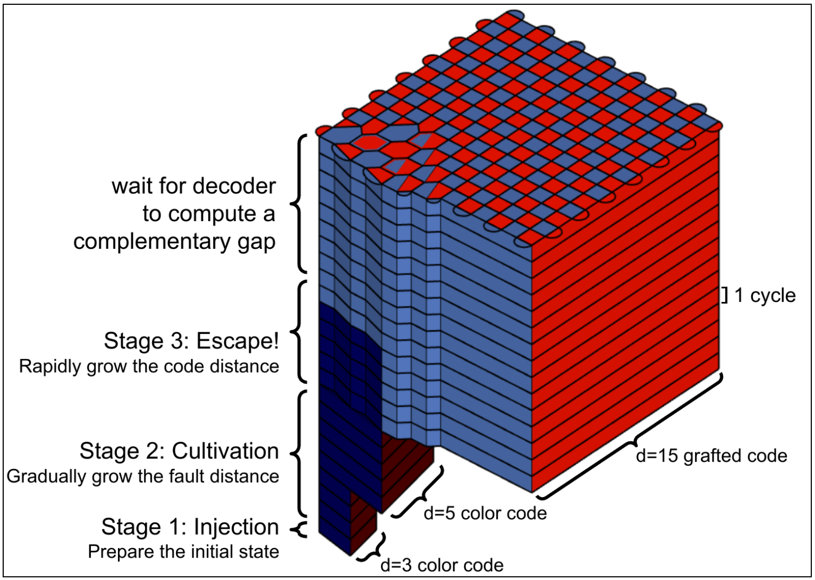
Sources of desynchronization
Magic state cultivation produces high-quality non-Clifford states with a low resource overhead
Fast classical feedback required:
For faulty T-measurements
Discarding a shot and restarting a new attempt when a detector fires
Other cultivation schemes† require fast, just-in-time decoding (faster: avoids post-selection)
Gidney, C., Shutty, N., & Jones, C. (2024). Magic state cultivation: growing T states as cheap as CNOT gates. arXiv preprint arXiv:2409.17595.
† Chamberland, C., & Noh, K. (2020). Very low overhead fault-tolerant magic state preparation using redundant ancilla encoding and flag qubits. npj Quantum Information, 6(1), 91.
Notes:
avoiding post-selection reduces average runtime of the protocol

Slide 33
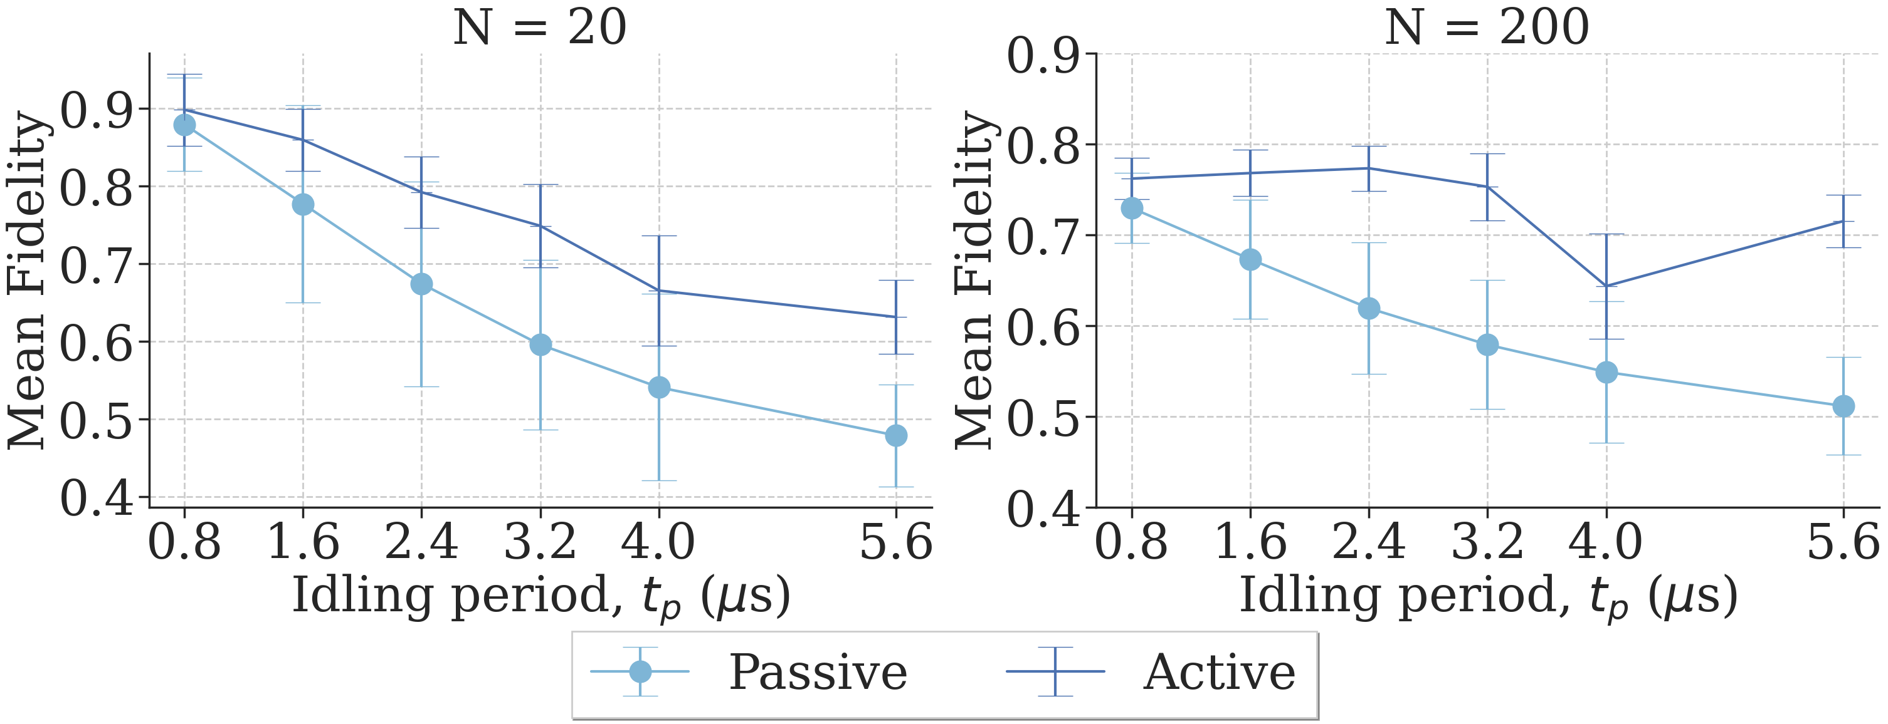
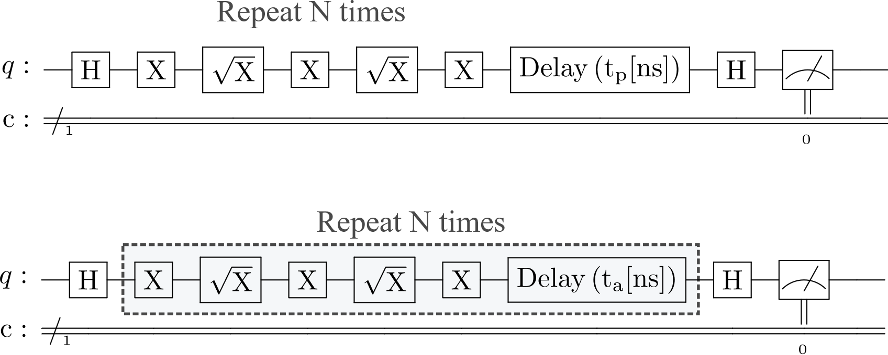
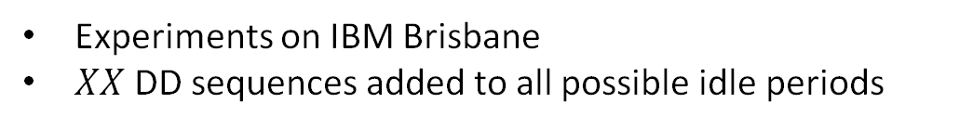
Can we do better than passively idle?
Emulates the passive policy
Experiments on IBM Brisbane
$XX$ DD sequences added to all possible idle periods
Breaking the idling period into smaller chunks helps reduce the impact of idling with the use of dynamical decoupling

Slide 34
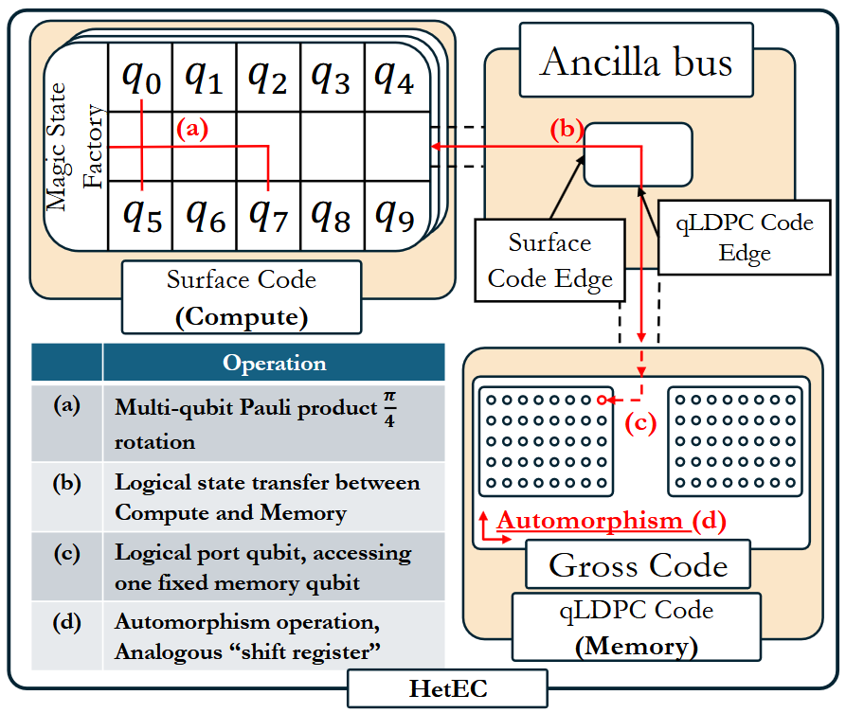
Sources of desynchronization
Magic state cultivation
qLDPC + Surface code computation
Heterogeneous codes will introduce desynchronization between logical qubits
Stein, S., Xu, S., Cross, A. W., Yoder, T. J., Javadi-Abhari, A., Liu, C., ... & Li, A. (2025, March). HetEC: Architectures for Heterogeneous Quantum Error Correction Codes. In Proceedings of the 30th ACM International Conference on Architectural Support for Programming Languages and Operating Systems, Volume 2 (pp. 515-528).
Gidney, C., Shutty, N., & Jones, C. (2024). Magic state cultivation: growing T states as cheap as CNOT gates. arXiv preprint arXiv:2409.17595.

Slide 35
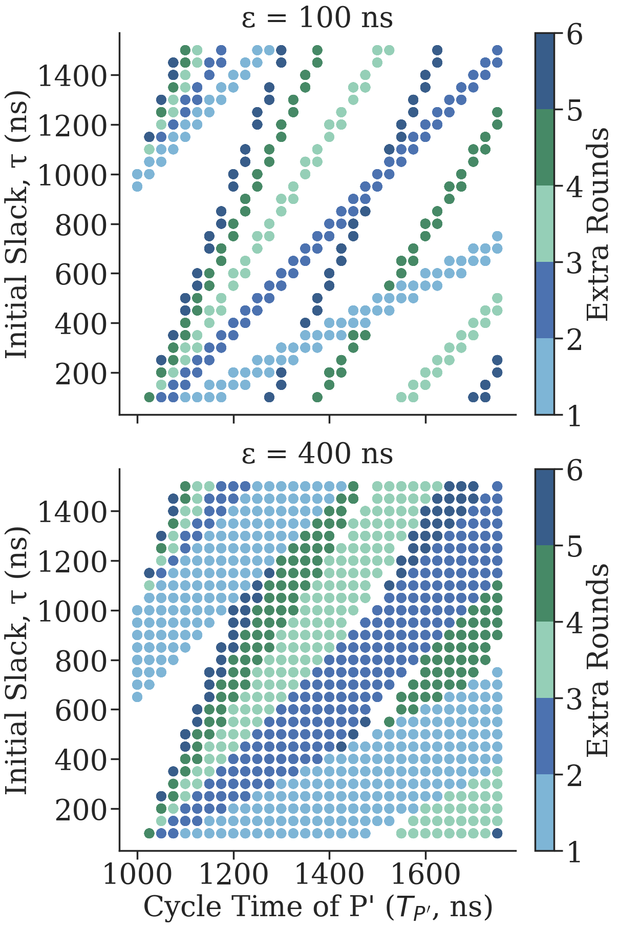

Optimizing the Hybrid policy
The idling period after every round ($τ$), and the number of extra rounds ($z$) can be computed using a modified Diophantine equation:
$$\left\lceil \frac{z.T_{P}+τ}{T_{P}^{′}}\right\rceil ×T_{P}^{′}−\left(z.T_{P}+τ\right)<ε$$
$ε$ is the idling tolerance parameter, used to define the maximum allowed idling period for synchronization
High values of $ε$ are good for a system with very variable slacks, lower values good for system with restricted values of slack
Notes:
Number of rounds -> eats into the algorithmic budget of LER per round

Slide 36


The Active-intra policy

Slide 37

Synchronizing $k$ patches
All two-patch synchronizations can be performed in parallel

Slide 38


Why does the Active policy work?

Slide 39

IBM repetition code idling experiment

Slide 40

Slack due to qLDPC+surface code system

Slide 41

Simulation results: LER reduction

Slide 42

Compilation overhead

Slide 43

Running extra rounds with Active synchronization

Slide 44

Idling is the best policy for neutral atom systems

